Slide 1
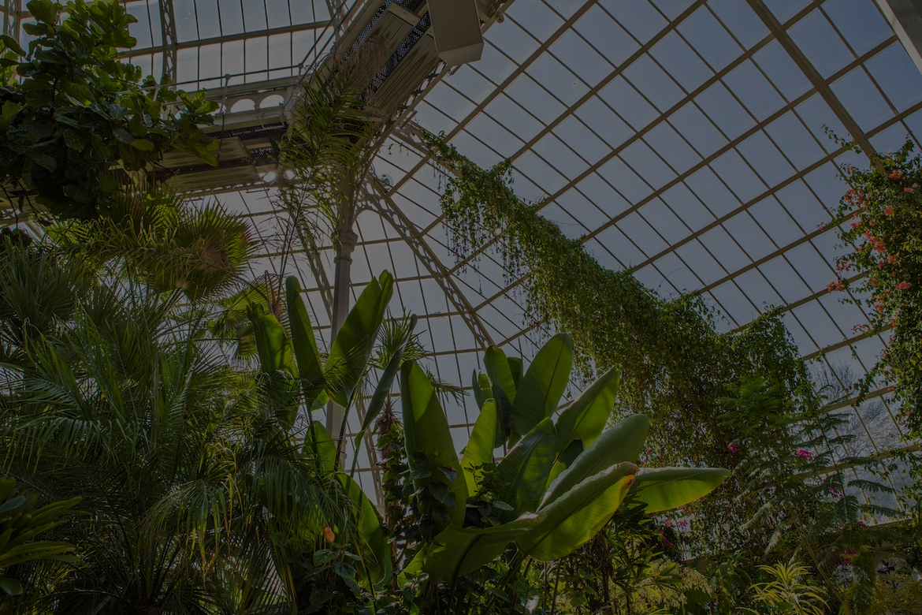


Cultivating Sustainability to Grow Sustainable Communities
Notes:
SeedHUB, logo, Punchline
Logo sdgs

Slide 2
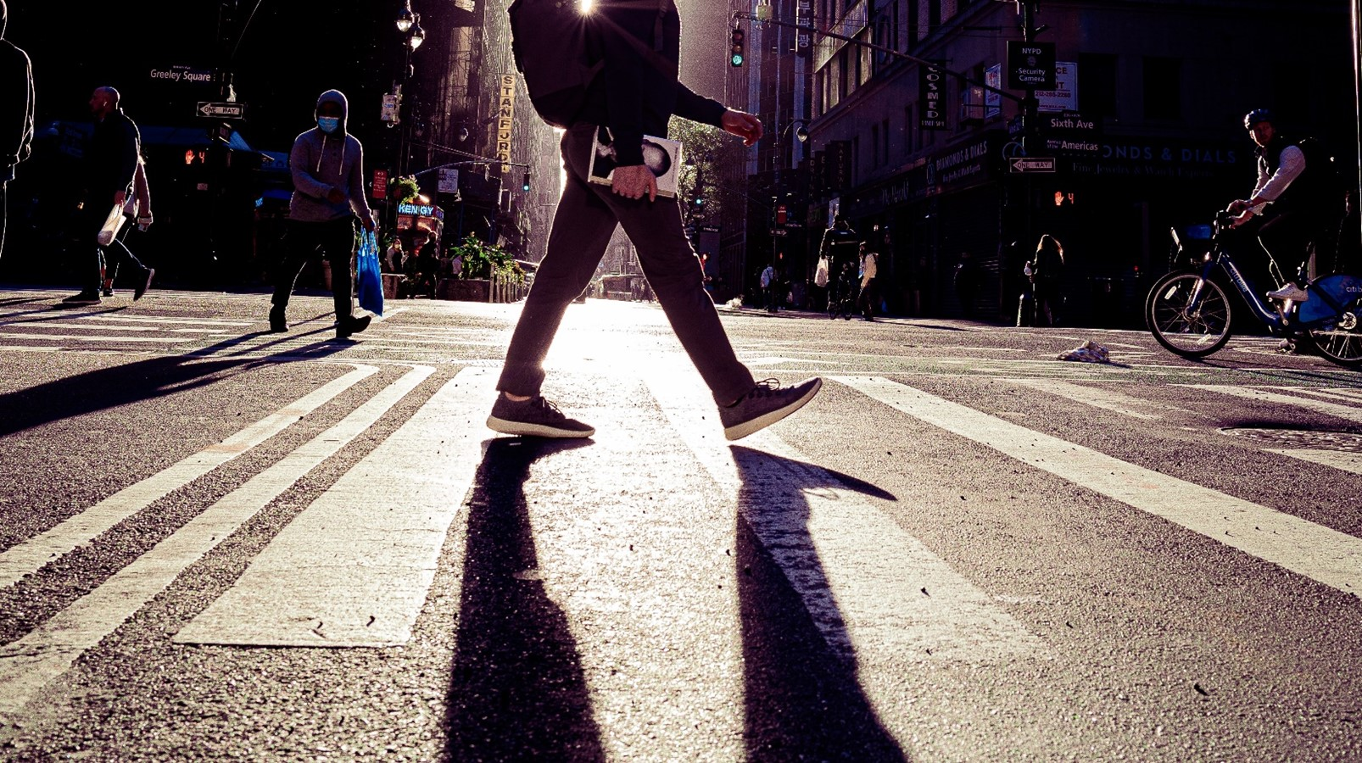



The Behavior
Notes:
Introduction
Context, the problem, customer reeducate people, environmental choice

Slide 3






































Notes:
Broad concept of the hub
The logo
Lot of leaves, each leaf one Thing
Seed is the learning hub

Slide 4













Community
Professionals
Workshops
Notes:
Broad concept of the hub
The logo
Lot of leaves, each leaf one Thing
Seed is the learning hub

Slide 5


